Slide 1
Standard User – Contracts Editor Features: Attachments Tab
February, 2013

Slide 2

Learning Objectives
Upon completion of this course you will be able to:
Attach a File or Multiple Files to a Contract Document
View an Attachment
Add an Attachment
Delete an Attachment
Print an Attachment

Slide 3
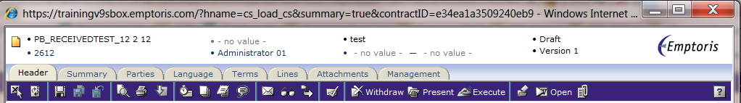
Contract Editor Toolbar and Tabs
The Contract Editor has several tabs and icons that you use to work on your contract. Tabs include:
Header tab: contains general information about your contract
Summary tab: displays a Management Summary; a single place to view key elements of the contract. This replaces cover sheets used for paper contracts and gives approvers a very clear summary of what the contract is about. It includes:
  Text area(s) to add additional information/summary about contract
  Terms
  Modified/replaced clauses – with or without the clause text
  Specific clauses
  Relationships
  Custom properties
  Activity – who reviewed this or who approved it
Parties: identifies the Internal Contact and External Party for the contract
Language tab: contains the contract language
Terms tab: contains the variable information and values defined by the template
Lines: applied to a Purchase or Sales Agreement and contains product/price information (not used)
Attachment tab: contains documents associated with your contract
Management tab: helps you manage the contract lifecycle (covered in later modules)
Notes:
NOTE: Performance tab is used in a module that COP chose not to purchase. Disregard that tab.

Slide 4
Attachments Tab
The Attachments tab is where you can add, view or modify attached files.
Attached files may be price lists, spreadsheets, diagrams, or other documents associated with the contract.
Attachments may be used even after a contract is complete, signed and executed.
  For example, the contract or just the signature page can be scanned and attached here.
Be clear on the difference between a language attachment containing the contract language (in the case of a Filed Contract, and only one is allowed) and regular attachments (any number of which can be added to any type of contract).
Attachments can be added to a Contract Template, and therefore are automatically added to contract instances based on that template
Note: Do not add attachments that have confidential information in them, because the attachment goes into the shared ECM repository (database).
Note: The recommended file size limit for an attachment is 10MB, and 100MB for all attachments in a contract.

Slide 5

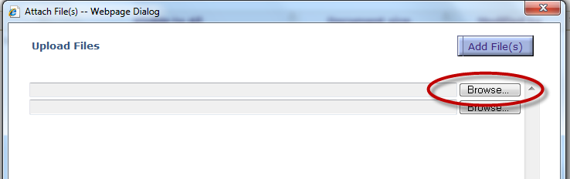
Attach a File (or Multiple Files)
To add an attachment, click the Add File icon on the main blue toolbar.
The Attach File dialog box is displayed.
Click the Browse button.

Slide 6
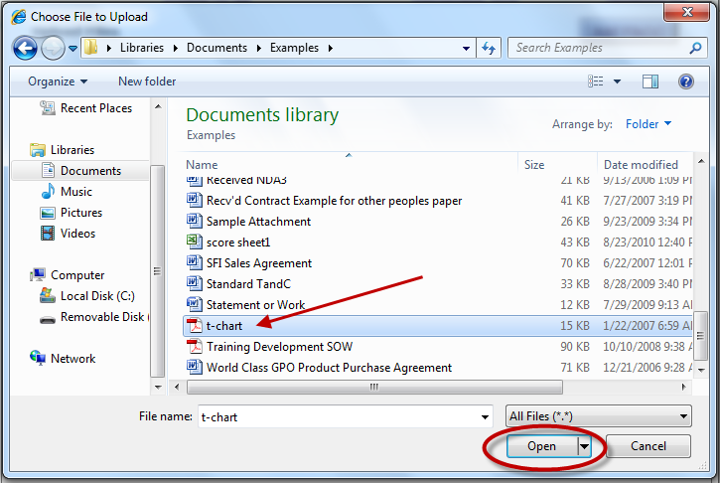
Attach a File (or Multiple Files), cont.
Navigate to the document location and click the File Name to highlight the file.
Click the Open button.
The selected file(s) are added to the Attach File list.
Click OK when done.

Slide 7
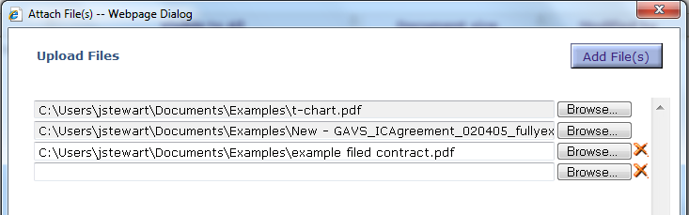
Attach a File (or Multiple Files), cont.
The selected file(s) are added to the Attach File list.
To remove an attachment, click the icon next the file name field.
Click OK when done
The selected files are added to the Attachments list.

Slide 8
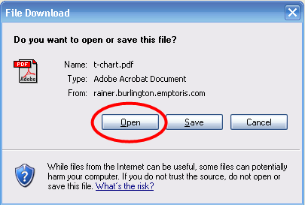
View an Attached File
Select the Visible to All checkbox if you want the attachment to be seen by all parties (i.e., external parties as well as internal ones). Check the box again to deselect and remove the option.
Click the hyperlink of the file name.
The File Download Dialog box is opened.
Click Open. The attached file is opened and
displayed.
  Note: To display a file, you must have the appropriate
  software application on your computer. For example,
  to view a .pdf file requires that Adobe Reader is installed.

Slide 9


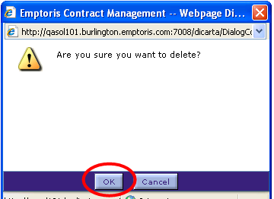
Delete an Attached File
Click the row to highlight the file name.
Click the Delete icon on the blue toolbar.
The Confirmation Dialog box is opened.
Click OK.
The file is deleted from the Attachments list.

Slide 10
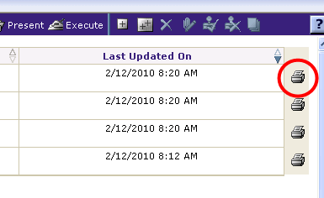
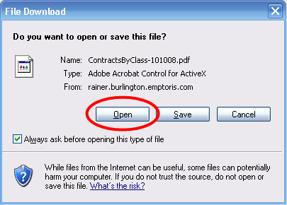
Print Attached Files
Click the Print Attachment icon for the attached file you want to print.
The File Download Dialog box is opened.
Click the Open button; the document is launched in Print Preview mode.
From the Print Dialog box, click Print as you normally do.
Click File > Close to return to the Attachments tab.

Slide 11

Questions?

